Slide 1
Welcome Back
Carstairs Primary School
2026/27

Slide 2


We are so pleased to have the new session off and rolling!
Our classes have all made a brilliant start to the year. We are already establishing our routines well and we are excited for what each class will achieve in the year ahead.
Our children are all looking so smart in their shiny new school uniforms!
We thank you, our parents, for the strong support we have had in getting the school year off to a smooth start.
Thank you for making sure that children are punctual and organised – long may this continue! ☺
Our school vision statement:
Be safe, be happy, be all you can be
Our school values:
Learning
Effort
Respect
Confidence
Kindness
We are a CAN DO school ☺

Slide 3
We hope you enjoy this little selection of photographs from our first few days. ☺

Slide 4
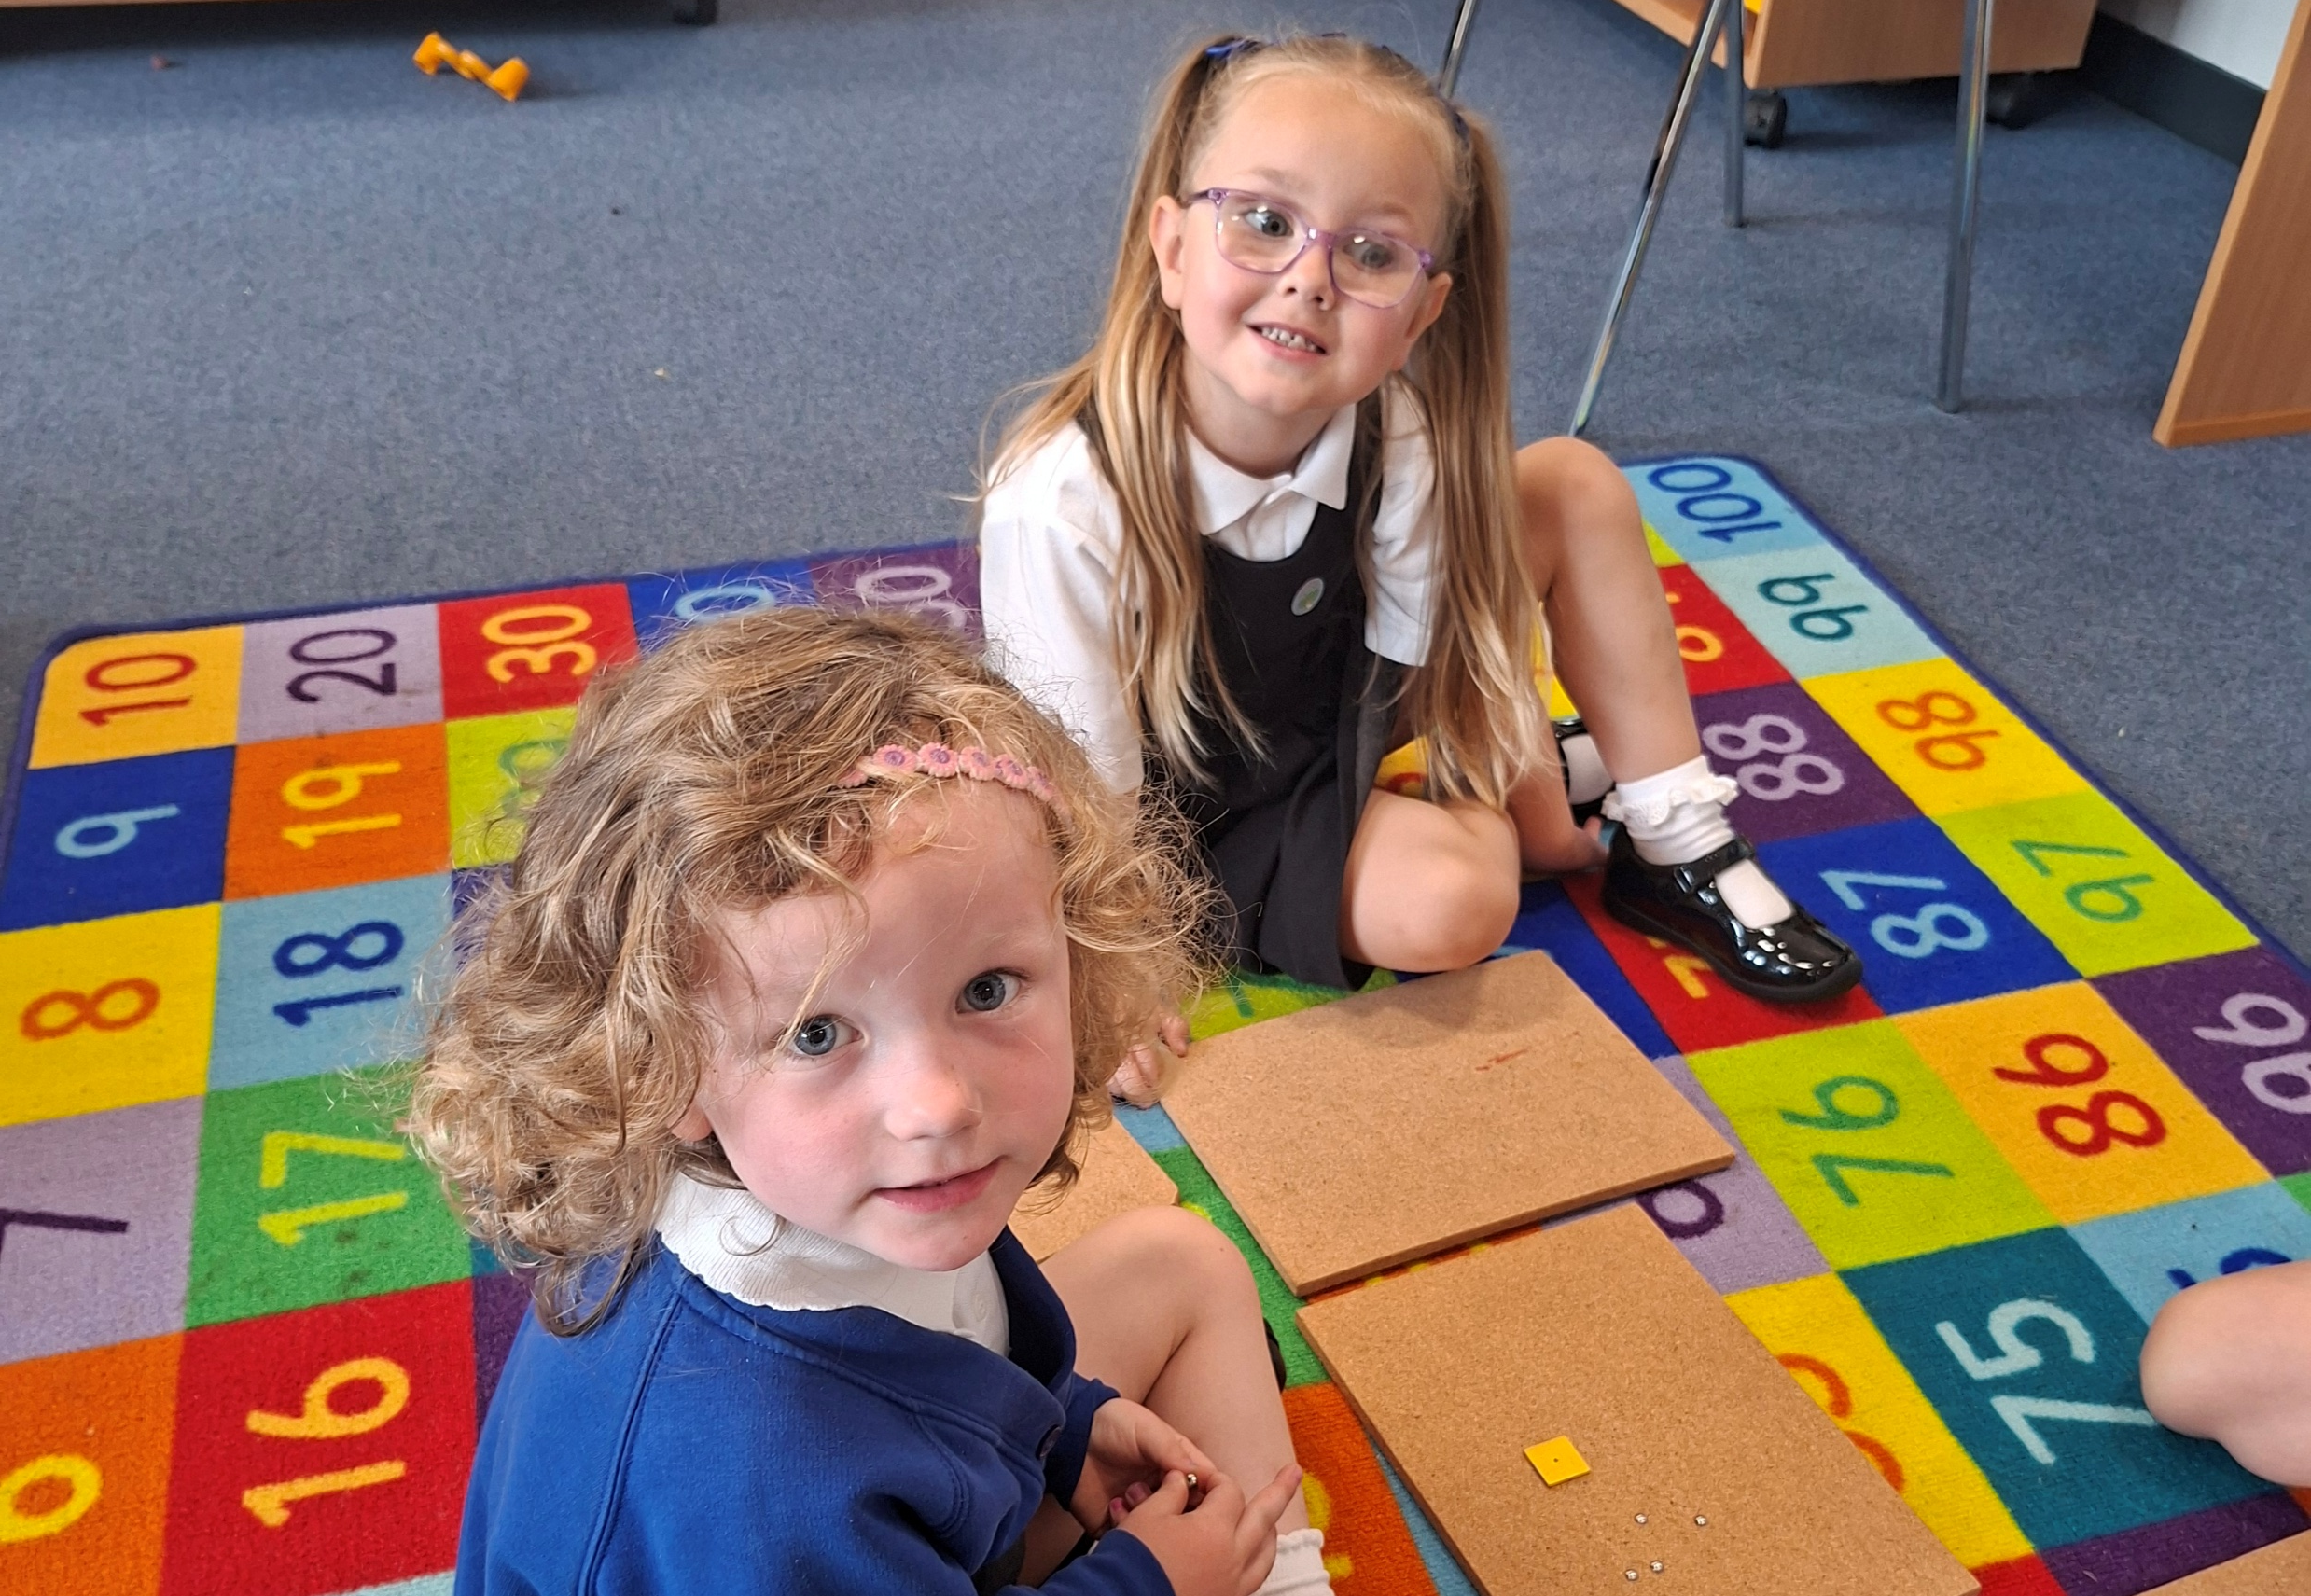

Slide 5
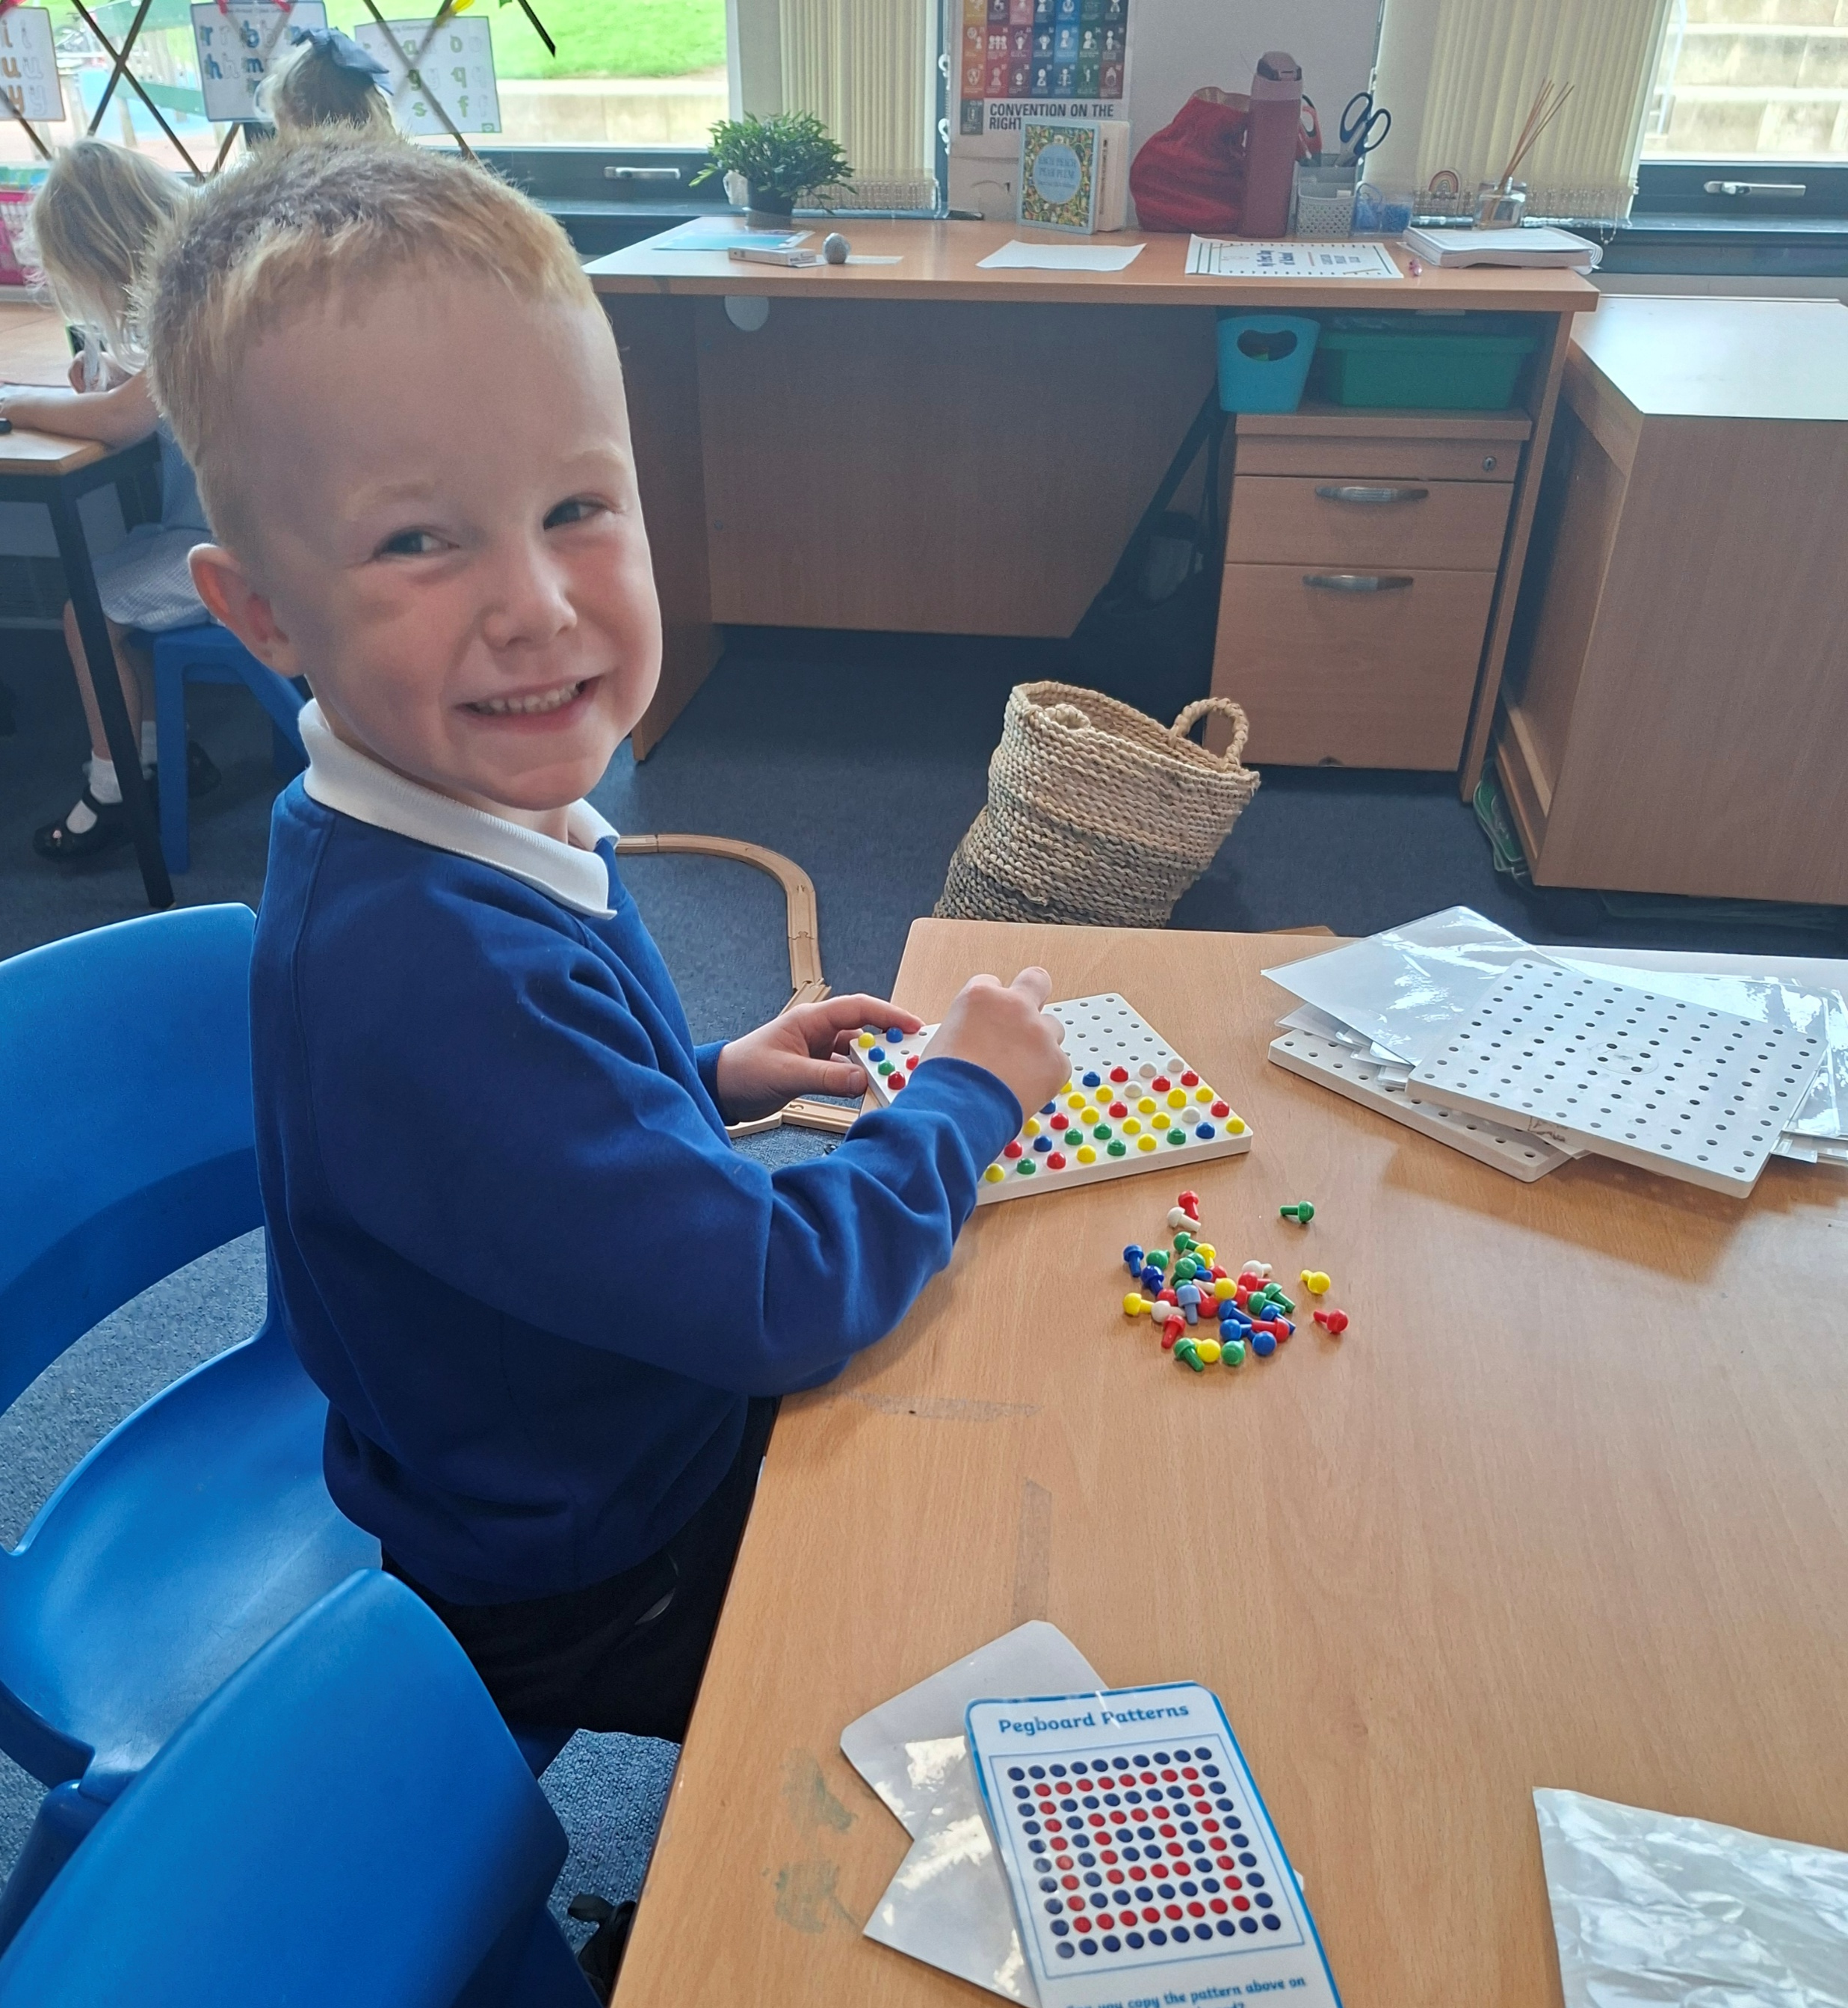
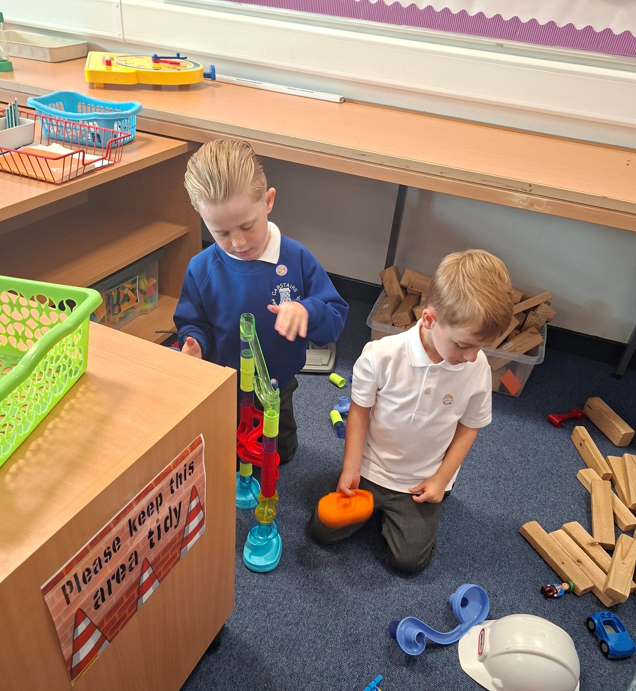


Slide 6
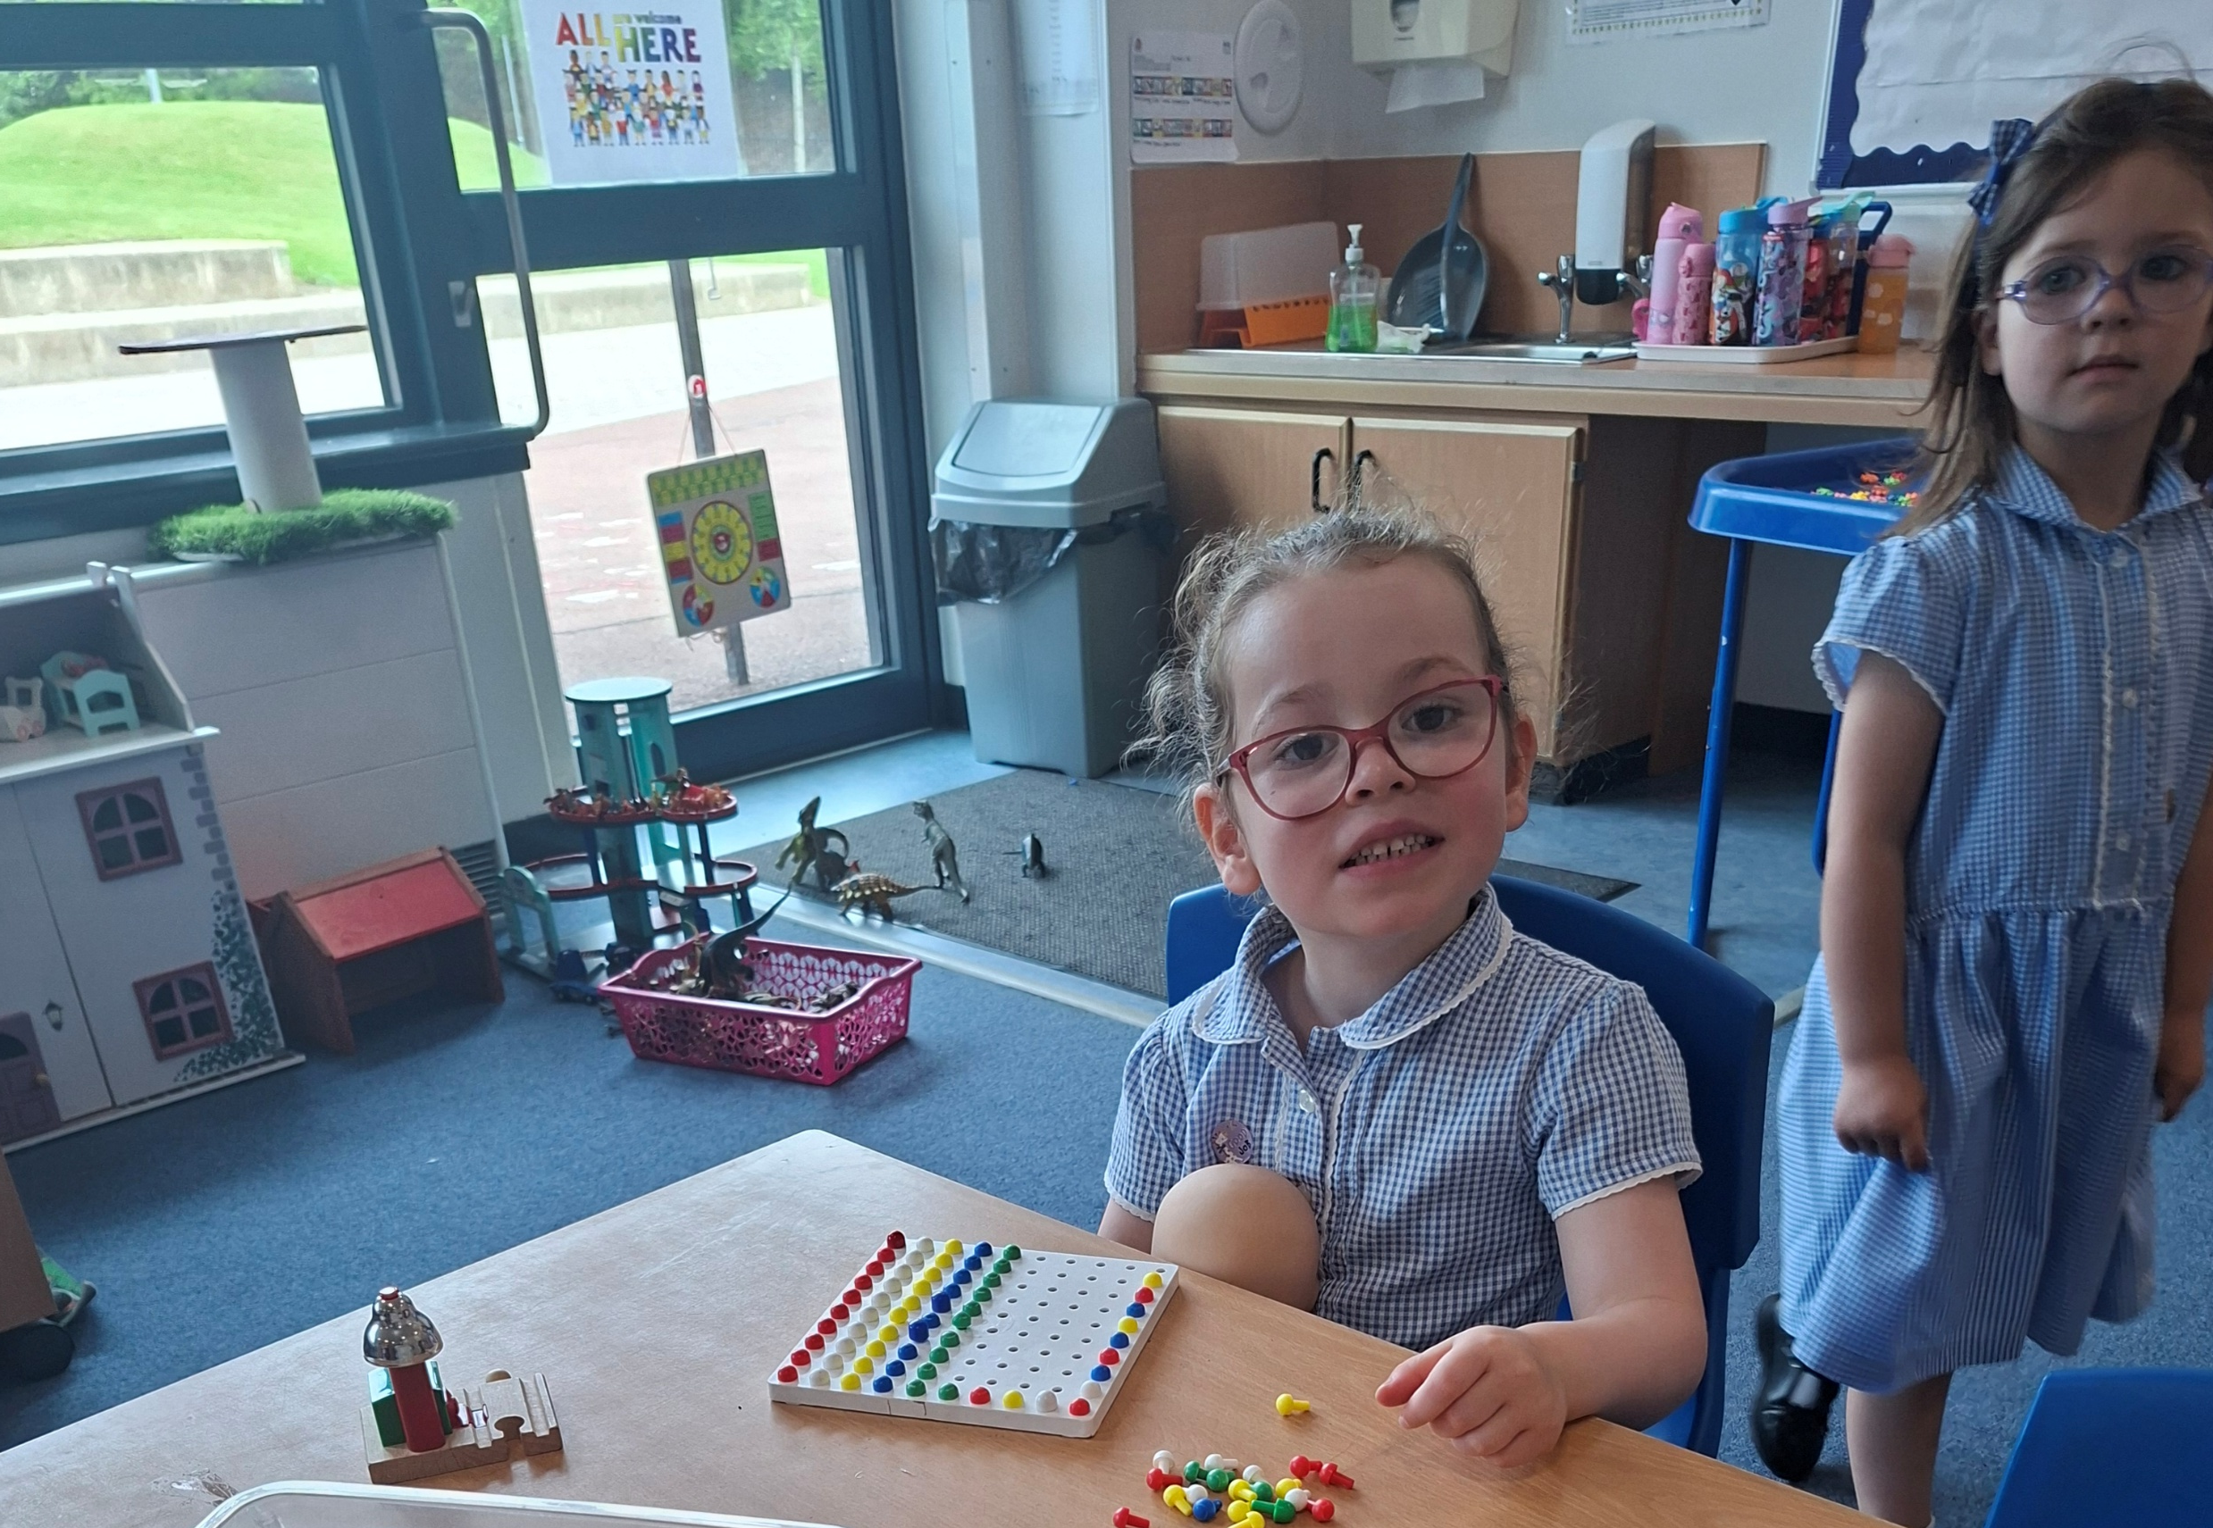

Slide 7
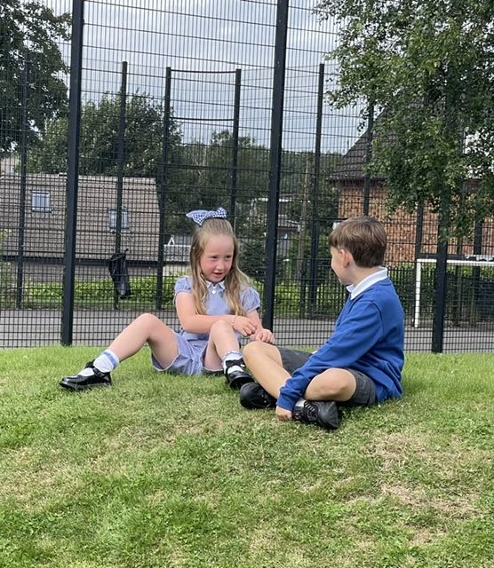
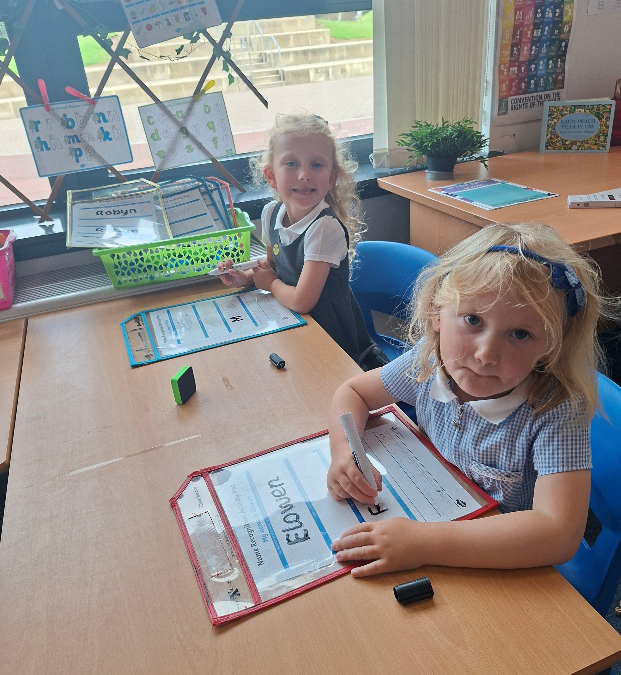

Slide 8
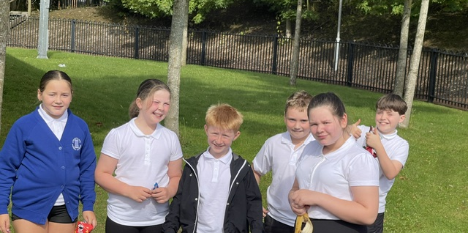

Slide 9
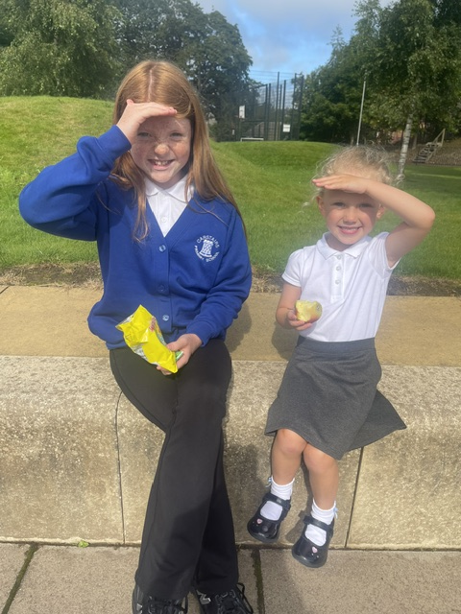

Slide 10
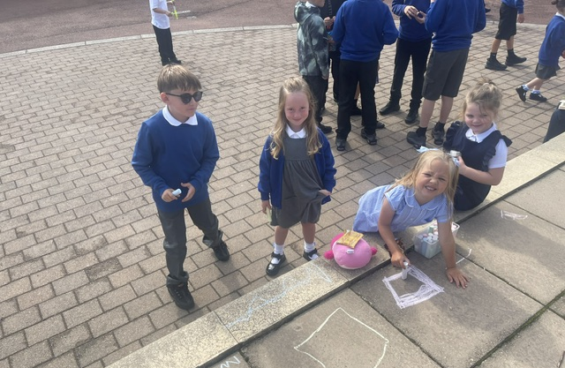

Slide 11
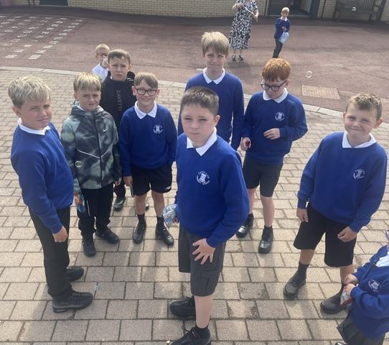
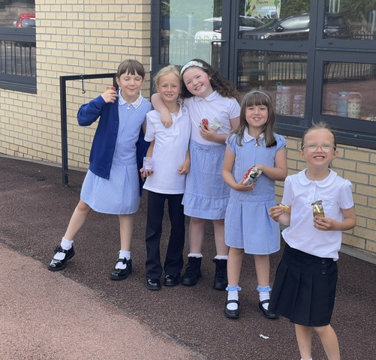

Slide 12
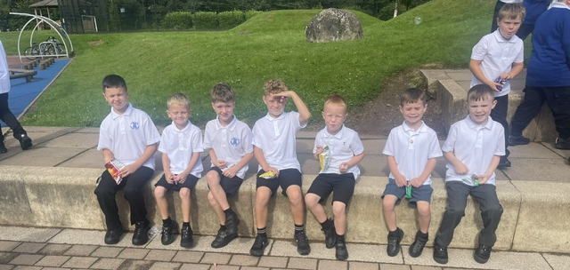

Slide 13
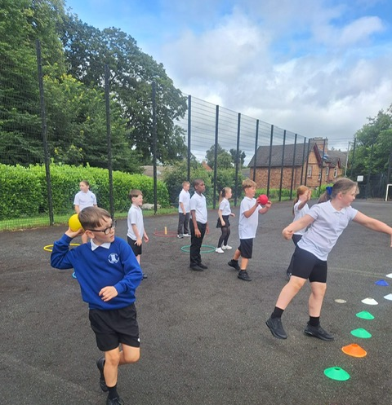
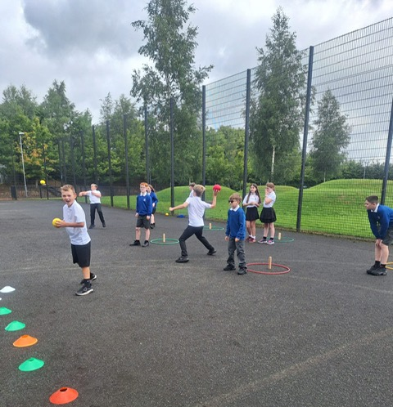

Slide 14
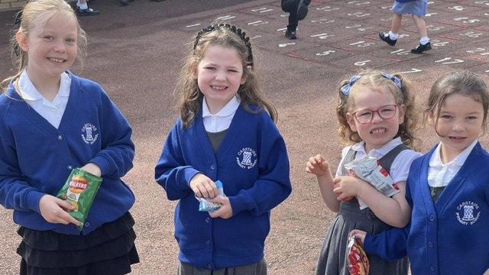

Slide 15
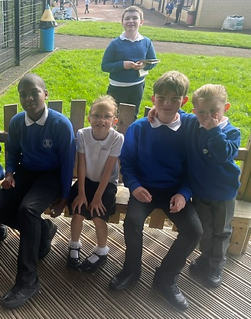
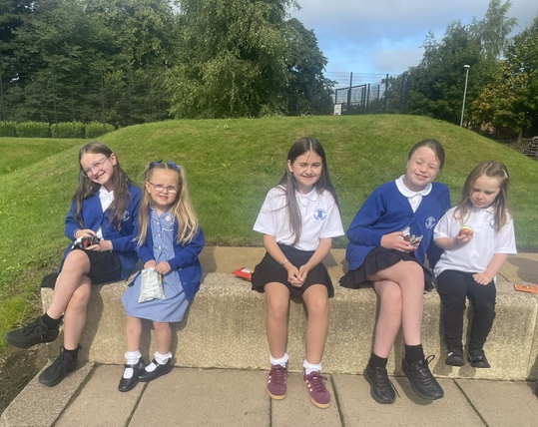

Slide 16
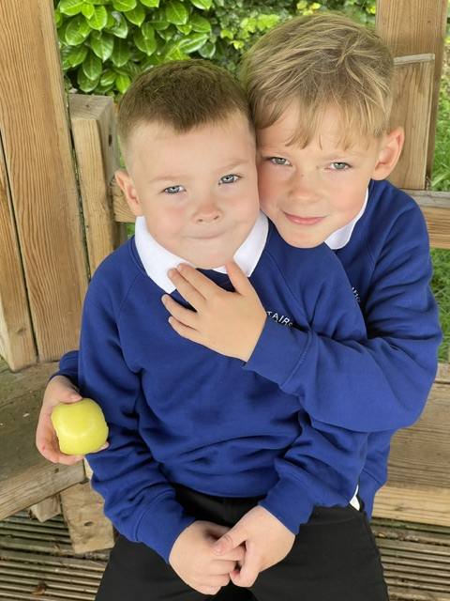
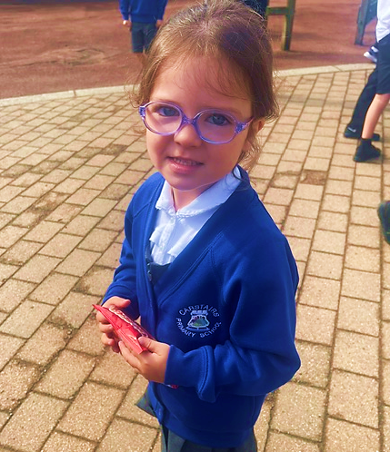

Slide 17
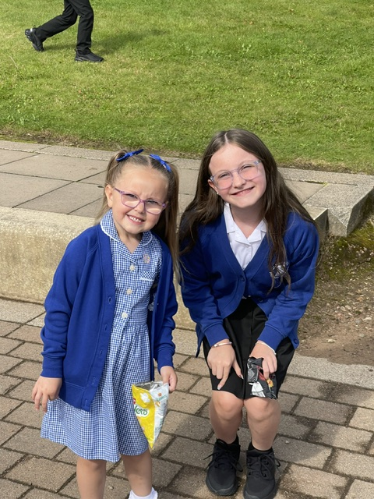
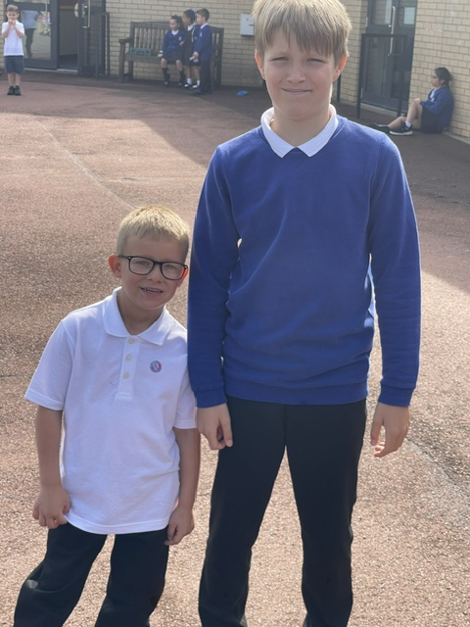

Slide 18
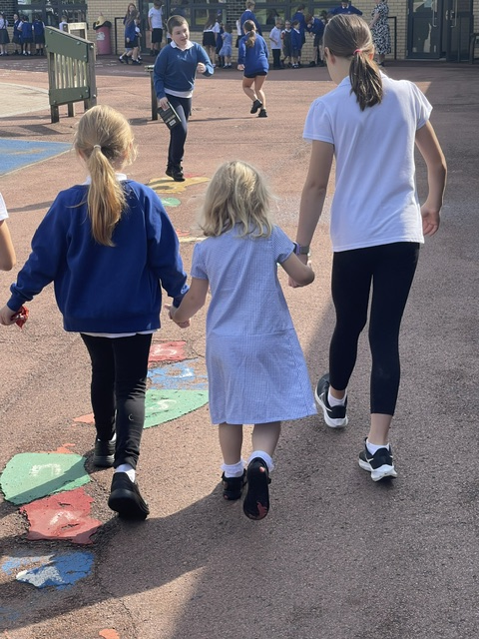
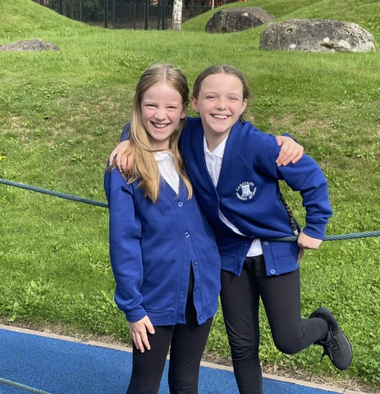

Slide 19


PE Days
Please see below for days that each class will have PE. Children must remember to bring their sturdy trainers in their bag on their PE days to change into for PE.
Base 1 with Mrs Casserly & Mrs Hardie
Wednesday and Thursday
Base 2 with Mrs Hodge
Monday and Thursday
Base 3 with Mrs Whitehead
Monday and Wednesday
Base 4 with Mrs Hunter & Mrs Allan
Monday and Thursday
Base 6 with Miss Colligan
Tuesday and Friday
Thank you for your support with this.

Slide 20

Have a lovely weekend and we look forward to welcoming all of our team back for our first FULL week of the new term! ☺

